Slide 1
Kubernetes Intermediate
Training

Slide 2
Kind
A Kubernetes "kind" cluster is a local Kubernetes cluster that runs inside Docker containers, using the tool kind (short for "Kubernetes IN Docker"). It is designed for testing and development purposes and allows users to create Kubernetes clusters without needing full-fledged cloud infrastructure or dedicated machines.
Kind is often used by developers to:
Test Kubernetes configurations and applications locally.
Develop Kubernetes operators, controllers, or CRDs (Custom Resource Definitions).
Run CI/CD pipelines for Kubernetes applications.

Slide 3
Pod scheduling
Pod scheduling in Kubernetes refers to the process by which the Kubernetes scheduler selects the most suitable node to run a pod.
This process ensures that the pod can function optimally while meeting any specific constraints or requirements.

Slide 4
pod scheduling process
1. Pod Requirements and Node Suitability
Before scheduling, Kubernetes evaluates each pod's requirements (resource needs, constraints, and any other scheduling rules) and matches them against the available nodes in the cluster. Some important factors include:
Resource requests: CPU, memory, and storage requirements.
Node affinity: Specific rules that determine whether a pod prefers or requires certain types of nodes (e.g., nodes with specific labels).
Taints and tolerations: Mechanisms to prevent pods from being scheduled on certain nodes unless the pod has a specific tolerance.
Pod affinity and anti-affinity: Rules that define whether a pod prefers or needs to be located near (or far from) other pods.
Node selectors: Conditions that filter nodes based on custom labels.

Slide 5
pod scheduling process
2. Filtering
Kubernetes first filters the nodes that can potentially run the pod. It excludes nodes that:
Don't have the necessary resources to satisfy the pod's resource requests.
Have taints that the pod doesn't tolerate.
Don't match the required labels (if nodeSelector or affinity rules are applied).

Slide 6
pod scheduling process
3. Scoring
Once Kubernetes identifies all nodes that meet the filtering criteria, it scores the nodes. Scoring helps the scheduler determine the best node based on factors such as:
Resource availability: Nodes with the most available resources might be preferred.
Pod distribution: The scheduler might aim to balance workloads across nodes to avoid hotspots.
Affinity rules: Nodes that match affinity preferences are scored higher.
Spread constraints: For example, distributing pods across zones or racks for availability purposes.

Slide 7
pod scheduling process
4. Binding
After scoring, Kubernetes selects the node with the highest score and binds the pod to that node. The pod is then scheduled to run on that specific node.
Common Features in Pod Scheduling:
Taints and Tolerations: Nodes can have "taints" that prevent pods from being scheduled on them unless those pods have corresponding "tolerations." This feature is often used to isolate certain nodes for specific workloads.
Affinity/Anti-affinity: You can define rules that control whether a pod is scheduled on the same node as another pod (affinity) or on different nodes (anti-affinity). This helps in spreading or grouping related workloads.
Preemption: When resources are scarce, higher-priority pods can preempt lower-priority pods, causing the lower-priority ones to be evicted to free up resources.

Slide 8
Node Affinity
Node affinity and anti-affinity are concepts in Kubernetes that control how pods are scheduled on nodes based on their labels. They allow you to express preferences or requirements for the nodes where your pods should run, enabling better management of workloads and resource utilization.
Node affinity allows you to constrain which nodes your pod can be scheduled on based on node labels. It is similar to the nodeSelector field but offers more flexibility and expressiveness.

Slide 9
Types of Node Affinity
RequiredDuringSchedulingIgnoredDuringExecution:
The scheduler must place the pod on a node that matches the specified labels. If no suitable node is found, the pod will not be scheduled.
This is a hard requirement.
PreferredDuringSchedulingIgnoredDuringExecution:
The scheduler will prefer to place the pod on nodes that match the specified labels, but it is not a hard requirement. If no preferred nodes are available, the pod may still be scheduled on other nodes.
This is a soft preference.

Slide 10
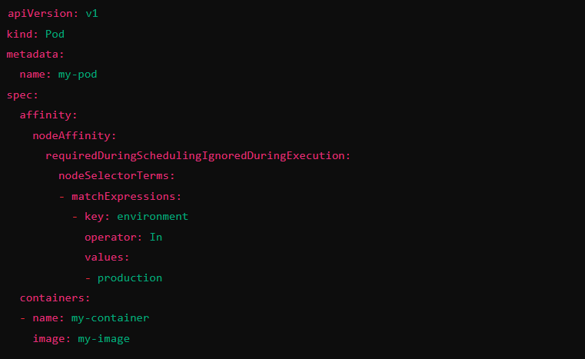
Types of Node Affinity

Slide 11
Node Anti-Affinity
Node anti-affinity is the opposite of node affinity. It allows you to specify rules that prevent a pod from being scheduled on certain nodes, typically based on labels of other pods running on those nodes. This can be useful for spreading workloads across nodes to improve availability and reduce the risk of single points of failure.

Slide 12
Types of Node Anti-Affinity
RequiredDuringSchedulingIgnoredDuringExecution:
The scheduler must not place the pod on a node that has certain labeled pods running on it. If it cannot find such a node, the pod will not be scheduled.
This is a hard requirement.
PreferredDuringSchedulingIgnoredDuringExecution:
The scheduler will prefer not to place the pod on nodes with specific labeled pods, but if no alternative nodes are available, the pod can still be scheduled on those nodes.
This is a soft preference.

Slide 13
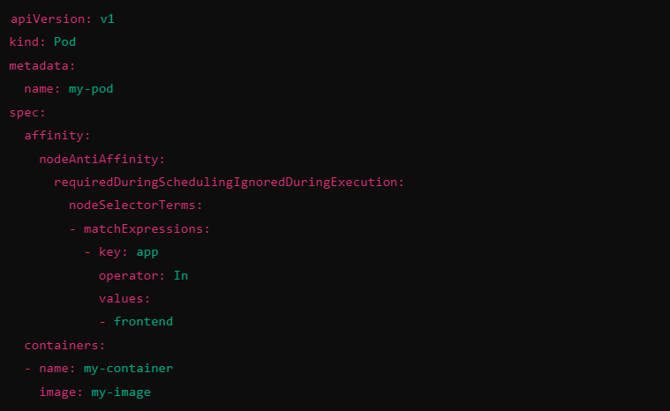
Types of Node Anti-Affinity

Slide 14
Node Affinity & Anti-Affinity
Node Affinity: Specifies where a pod should run based on node labels (can be hard or soft requirements).
Node Anti-Affinity: Specifies where a pod should not run based on the presence of certain labels on other pods (can also be hard or soft requirements).
Both node affinity and anti-affinity allow you to define more sophisticated scheduling behaviors, enhancing resource management, and increasing the reliability and resilience of your applications running on Kubernetes.

Slide 15
Exercise
# List nodes in the cluster
kubectl get nodes
# Label a node
kubectl label node <node-name> environment=production
kubectl label node ip-192-168-1-100.ec2.internal environment=production

Slide 16
Exercise: Apply Node Affinity to a Pod
apiVersion: v1
kind: Pod
metadata:
name: affinity-pod
spec:
affinity:
nodeAffinity:
requiredDuringSchedulingIgnoredDuringExecution:
nodeSelectorTerms:
- matchExpressions:
- key: environment
operator: In
values:
- production
containers:
- name: nginx
image: nginx

Slide 17
Exercise: Apply Node Anti-Affinity to a Pod
apiVersion: v1
kind: Pod
metadata:
name: anti-affinity-pod
spec:
affinity:
nodeAffinity:
requiredDuringSchedulingIgnoredDuringExecution:
nodeSelectorTerms:
- matchExpressions:
- key: environment
operator: NotIn
values:
- development
containers:
- name: nginx
image: nginx

Slide 18
Taint and Toleration
Taints and tolerations in Kubernetes are mechanisms used to control how pods are scheduled on nodes, allowing you to define rules that prevent or allow certain pods from being placed on specific nodes.
This feature ensures that workloads are placed appropriately based on node capabilities or other criteria.

Slide 19
Taints
A taint is applied to a node to mark it in a way that only pods with matching tolerations can be scheduled on it. Nodes with taints effectively repel pods unless those pods explicitly state they can tolerate the taint.
Taints are defined with three key elements:
Key: A label key that identifies the taint.
Value: A value for the taint.

Slide 20
Taints
Effect: The action Kubernetes should take when a pod does not tolerate the taint. There are three possible effects:
NoSchedule: Pods without a matching toleration will not be scheduled on the node.
PreferNoSchedule: Kubernetes will try to avoid scheduling pods on this node, but it's not a strict rule.
NoExecute: If a pod is already running on the node, it will be evicted unless it has a matching toleration.
kubectl taint nodes node1 dedicated=production:NoSchedule

Slide 21
Tolerations
A toleration is applied to a pod, indicating that the pod can "tolerate" a node’s taint. Tolerations allow the pod to bypass the restriction imposed by the taint and be scheduled on that node.
Tolerations are defined with:
Key: Matches the taint’s key.
Operator: Specifies how the pod matches the taint key. Common values are Equal (for equality matching) and Exists (only requires the key).
Value: Matches the taint's value.
Effect: Matches the taint's effect (either NoSchedule, PreferNoSchedule, or NoExecute).

Slide 22
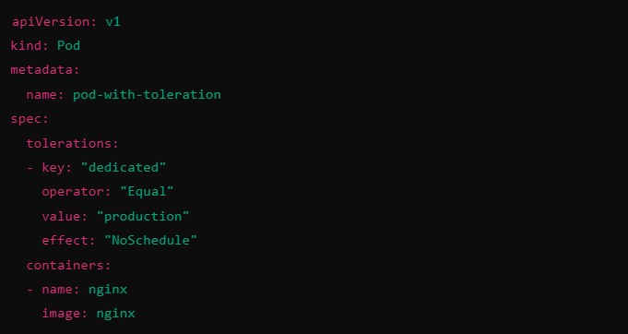
Tolerations

Slide 23
Use Cases & Summary
Dedicated workloads: Use taints to reserve specific nodes for certain workloads (e.g., production, testing).
Node isolation: Ensure that only certain workloads (e.g., high-memory workloads) run on nodes with specialized hardware.
Graceful node maintenance: Apply a NoExecute taint to evict all pods from a node in preparation for maintenance.
Taints are applied to nodes to restrict what pods can be scheduled there.
Tolerations are applied to pods, allowing them to be scheduled on nodes with specific taints.
This mechanism is key for controlling workload placement and managing nodes with specialized purposes or resource constraints.

Slide 24
Exercise
kubectl get nodes
kubectl taint nodes ip-192-168-1-100.ec2.internal dedicated=production:NoSchedule

Slide 25
Exercise: Create a Pod Without a Toleration (Will Not Be Scheduled)
Let's create a pod without a toleration. This pod will not be scheduled on the node tainted with dedicated=production.
apiVersion: v1
kind: Pod
metadata:
name: pod-without-toleration
spec:
containers:
- name: nginx
image: nginx

Slide 26
Exercise: Create a Pod With a Matching Toleration
Next, we’ll create a pod with a toleration that allows it to be scheduled on the node with the dedicated=production taint.
apiVersion: v1
kind: Pod
metadata:
name: pod-with-toleration
spec:
tolerations:
- key: "dedicated"
operator: "Equal"
value: "production"
effect: "NoSchedule"
containers:
- name: nginx
image: nginx

Slide 27
Helm
The package manager for Kubernetes
Helm is the best way to find, share, and use software built for Kubernetes.
Helm helps you manage Kubernetes applications — Helm Charts help you define, install, and upgrade even the most complex Kubernetes application.
Charts are easy to create, version, share, and publish — so start using Helm and stop the copy-and-paste.
Helm is a graduated project in the CNCF and is maintained by the Helm community.

Slide 28
Helm
Helm is a tool for managing Kubernetes packages called charts. Helm can do the following:
Create new charts from scratch
Package charts into chart archive (tgz) files
Interact with chart repositories where charts are stored
Install and uninstall charts into an existing Kubernetes cluster
Manage the release cycle of charts that have been installed with Helm

Slide 29
Helm
For Helm, there are three important concepts:
The chart is a bundle of information necessary to create an instance of a Kubernetes application.
The config contains configuration information that can be merged into a packaged chart to create a releasable object.
A release is a running instance of a chart, combined with a specific config.

Slide 30
Helm
Helm is an executable which is implemented into two distinct parts:
The Helm Client is a command-line client for end users. The client is responsible for the following:
Local chart development
Managing repositories
Managing releases
Interfacing with the Helm library
Sending charts to be installed
Requesting upgrading or uninstalling of existing releases

Slide 31
Helm
The Helm Library provides the logic for executing all Helm operations. It interfaces with the Kubernetes API server and provides the following capability:
Combining a chart and configuration to build a release
Installing charts into Kubernetes, and providing the subsequent release object
Upgrading and uninstalling charts by interacting with Kubernetes
The standalone Helm library encapsulates the Helm logic so that it can be leveraged by different clients.

Slide 32
Helm
The Helm client and library is written in the Go programming language.
The library uses the Kubernetes client library to communicate with Kubernetes. Currently, that library uses REST+JSON. It stores information in Secrets located inside of Kubernetes. It does not need its own database.
Configuration files are, when possible, written in YAML.

Slide 33
Helm Install
Prerequisites
The following prerequisites are required for a successful and properly secured use of Helm.
A Kubernetes cluster
Deciding what security configurations to apply to your installation, if any
Installing and configuring Helm.
Install guide
https://helm.sh/docs/intro/install/

Slide 34
Helm
A Chart is a Helm package. It contains all of the resource definitions necessary to run an application, tool, or service inside of a Kubernetes cluster. Think of it like the Kubernetes equivalent of a Homebrew formula, an Apt dpkg, or a Yum RPM file.
A Repository is the place where charts can be collected and shared. It's like Perl's CPAN archive or the Fedora Package Database, but for Kubernetes packages.
A Release is an instance of a chart running in a Kubernetes cluster. One chart can often be installed many times into the same cluster. And each time it is installed, a new release is created. Consider a MySQL chart. If you want two databases running in your cluster, you can install that chart twice. Each one will have its own release, which will in turn have its own release name.

Slide 35
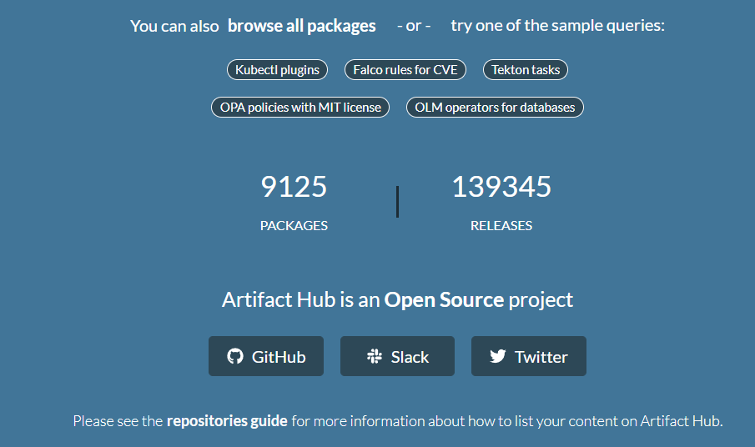
Helm Repo
https://artifacthub.io/

Slide 36
'helm search': Finding Charts
Helm comes with a powerful search command. It can be used to search two different types of source:
helm search hub searches the Artifact Hub, which lists helm charts from dozens of different repositories.
helm search repo searches the repositories that you have added to your local helm client (with helm repo add). This search is done over local data, and no public network connection is needed.

Slide 37
Commands
helm repo list
helm repo add bitnami https://charts.bitnami.com/bitnami
helm search repo bitnami
helm repo list
helm repo remove bitnami
helm repo add bitnami https://charts.bitnami.com/bitnami
helm search repo mysql
helm search repo database
helm search repo database --versions
#search from hub
helm search hub wordpresst

Slide 38
Commands
$add another repo
helm repo add brigade https://brigadecore.github.io/charts
#install with default name
helm install bitnami/mysql --generate-name
helm uninstall mysql-1612624192
helm status mysql-1612624192
helm install mydb bitnami/mysql
helm show values bitnami/mysql
kubectl get pods
helm list
helm istall mydb -n mynamespace
helm list --namespace mynamespace

Slide 39
Commands
helm uninstall mydb -n mynamespace
helm install happy-panda bitnami/wordpress
helm upgrade -f panda.yaml happy-panda bitnami/wordpress
#to have custom name
CHALLENGE
Run wordpress chart
to view chart
helm pull chartrepo/chartname
helm template nginx bitnami/nginx
helm install nginx bitnami/nginx --dry-run

Slide 40
Commands
helm get notes nginx
helm get values nginx
helm get values nginx --revision 2
helm get manifest nginx
helm history nginx
helm rollback nginx 2
helm uninstall nginx --keep-history

Slide 41
Create your own chart
helm create mychart
cd mychart
ls
cd ..
helm install release1 ./mychart
helm ls
kubectl get all
helm get manifest release1
rm -rf ./mychart

Slide 42
Create your own chart
helm create mychart
rm -rf mychart/templates/*
cd mychart/templates
#create a new file called configmap.yaml
code configmap.yaml
#add below content
apiVersion: v1
kind: ConfigMap
metadata:
name: {{ .Release.Name }}-configmap
data:
myvalue: "Sample Config Map"

Slide 43
Create your own chart
cd ..
cd ..
helm install release-configmap ./mychart
helm ls
helm get manifest release-configmap
kubectl describe configmaps mychart-configmap
helm uninstall release-configmap

Slide 44
Create your own chart - Built-in func
#Modify configmap.yml with below code
apiVersion: v1
kind: ConfigMap
metadata:
name: {{ .Release.Name }}-configmap
data:
myvalue: "Sample Config Map"
helm install releasename-test ./mychart
helm get manifest releasename-test
helm install --debug --dry-run dryrun-test ./mychart
kubectl describe configmaps releasename-test-configmap
helm uninstall releasename-test
https://helm.sh/docs/chart_template_guide/builtin_objects/

Slide 45
Create your own chart - Read value from values.yml
#delete content from values.yml and add below value
costCode: CC98112
#replace configmap.yml with below code
apiVersion: v1
kind: ConfigMap
metadata:
name: {{ .Release.Name }}-configmap
data:
myvalue: "Sample Config Map"
costCode: {{ .Values.costCode }}
helm install --debug --dry-run dryrun ./mychart
helm install firstvalue ./mychart
helm get manifest firstvalue
kubectl describe configmaps firstvalue-configmap

Slide 46
Create your own chart - Set value from values.yml
helm install --dry-run --debug --set costCode=CC00000 valueseteg ./mychart
helm install valueseteg ./mychart --set costCode=CC00000
helm get manifest valueseteg
kubectl describe configmaps valueseteg-configmap
helm ls
helm uninstall valueseteg

Slide 47
Create your own chart - template functions
#add below content to value.yml
costCode: CC98112
projectCode:
infra:
zone: a,b,c
region: us-east-1
Add below code to configmap.yml
apiVersion: v1
kind: ConfigMap
metadata:
name: {{ .Release.Name }}-configmap
data:
myvalue: "Sample Config Map"
costCode: {{ .Values.costCode }}
Zone: {{ quote .Values.infra.zone }}
Region: {{ quote .Values.infra.region }}
ProjectCode: {{ upper .Values.projectCode }}
helm install --dry-run --debug valueseteg ./mychart

Slide 48
Create your own chart - pipelines
#add below content to value.yml
costCode: CC98112
projectCode:
infra:
zone: a,b,c
region: us-east-1
Add below code to configmap.yml
apiVersion: v1
kind: ConfigMap
metadata:
name: {{ .Release.Name }}-configmap
data:
myvalue: "Sample Config Map"
costCode: {{ .Values.costCode }}
Zone: {{ quote .Values.infra.zone }}
Region: {{ quote .Values.infra.region }}
ProjectCode: {{ upper .Values.projectCode }}
pipeline: {{ .Values.projectCode | upper | quote }}
now: {{ now | date "2006-01-02" | quote }}
contact: {{ .Values.contact | default "1-800-123-0000" | quote }}
helm install --dry-run --debug valueseteg ./mychart
helm install --dry-run --debug --set contact=1-800-800-8888 valueseteg ./mychart

Slide 49
Create your own chart - control flow
#add below content to value.yml
costCode: CC98112
projectCode: 3242S
infra:
zone: a,b,c
region: us-east-1
Add below code to configmap.yml
apiVersion: v1
kind: ConfigMap
metadata:
name: {{ .Release.Name }}-configmap
data:
myvalue: "Sample Config Map"
costCode: {{ .Values.costCode }}
Zone: {{ quote .Values.infra.zone }}
Region: {{ quote .Values.infra.region }}
ProjectCode: {{ upper .Values.projectCode }}
pipeline: {{ .Values.projectCode | upper | quote }}
now: {{ now | date "2006-01-02" | quote }}
contact: {{ .Values.contact | default "1-800-123-0000" | quote }}
{{ if eq .Values.infra.region "us-east-1" }}ha: true{{ end }}
helm install --dry-run --debug controlif ./mychart

Slide 50
Create your own chart - control flow
#add below content to value.yml
costCode: CC98112
projectCode: 3242S
infra:
zone: a,b,c
region: us-west-1
helm install --dry-run --debug controlif ./mychart
#you should not get HA true

Slide 51
Building production ready cluster
Cluster Planning and Sizing
Security Best Practices
Networking Best Practices
Observability and Monitoring
High Availability and Disaster Recovery
Resource Management
CI/CD Pipeline Integration
Cost Management
Cluster Upgrades and Maintenance
Backup and Rollback Strategies
Encryption and Data Protection

Slide 52
Cluster Planning and Sizing
Node Size and Number: Plan your node sizes (vCPU, memory) based on the workload requirements. Ensure that you have sufficient resources for growth and redundancy.
Multi-AZ Deployment: Ensure high availability by deploying the Kubernetes control plane and worker nodes across multiple availability zones (AZs) to avoid single points of failure.
Auto-scaling: Implement both Cluster Autoscaler and Horizontal Pod Autoscaler (HPA) to dynamically adjust the size of your cluster and scale workloads based on traffic.

Slide 53
Security Best Practices
RBAC: Enable Role-Based Access Control (RBAC) to enforce strict access policies and permissions for different users and service accounts.
Pod Security Policies: Define and enforce pod security policies or use PodSecurity admission to control the security context under which pods run (e.g., running non-root, restricting capabilities).
Network Policies: Use Kubernetes network policies to control the communication between pods, limiting pod-to-pod communication and reducing the blast radius in case of a breach.
Secrets Management: Use Kubernetes secrets for storing sensitive information such as database credentials or API keys. Integrate with external secret management solutions like AWS Secrets Manager or HashiCorp Vault for better control.
Control Plane Security: Ensure the Kubernetes API server is not exposed directly to the internet. Use VPN or IAM to restrict access. Protect etcd with encryption at rest and secure communication via TLS.
Image Security: Use signed, trusted, and vulnerability-free container images by scanning your images using tools like Clair, Trivy, or Anchore. Use admission controllers to enforce image policies.

Slide 54
Networking Best Practices
CNI Plugin: Choose a scalable Container Network Interface (CNI) plugin such as AWS VPC CNI (for EKS), Calico, or Cilium, based on your performance and security needs.
Service Type: For external access, use a LoadBalancer service with proper annotations to ensure the right type of AWS load balancer (NLB, ALB). Use Ingress controllers like AWS Load Balancer Controller or NGINX for routing traffic.
DNS Management: Ensure DNS records are properly set up for services, and use a reliable internal DNS setup. Consider using CoreDNS for name resolution.

Slide 55
Observability and Monitoring
Logging: Use centralized logging solutions like ELK (Elasticsearch, Logstash, Kibana), Fluentd, or AWS CloudWatch Logs to capture logs from all pods and system components. Enable logging for the control plane (e.g., Kubernetes API server logs).
Monitoring: Implement monitoring with tools like Prometheus and Grafana. Monitor cluster metrics, node health, application performance, and resource utilization. Set up alerts for key metrics like CPU, memory usage, and pod restarts.
Tracing: Use distributed tracing with tools like Jaeger or AWS X-Ray for tracing microservice transactions and identifying performance bottlenecks.

Slide 56
High Availability and Disaster Recovery
Control Plane HA: Use a managed Kubernetes service like EKS, GKE, or AKS to get a highly available control plane. For self-managed clusters, ensure redundancy in the control plane by deploying multiple master nodes across different AZs.
Worker Node HA: Spread worker nodes across multiple AZs to avoid failure due to AZ-specific issues. Use auto-scaling groups to ensure enough nodes are always available.
Backup and Disaster Recovery: Regularly back up etcd (for control plane state) and persistent volumes (for application data). Use tools like Velero for backing up Kubernetes resources and data. Ensure a recovery plan is in place.

Slide 57
Resource Management
Resource Requests and Limits: Define resource requests and limits for all containers to ensure pods get the required CPU and memory, preventing resource starvation or over-provisioning.
Quota Management: Implement ResourceQuotas and LimitRanges to restrict resource usage per namespace and prevent any single team or service from consuming excessive resources.
Namespace Segmentation: Organize workloads into namespaces to isolate teams, applications, or environments (e.g., dev, staging, production). Use RBAC to control access to specific namespaces.

Slide 58
CI/CD Pipeline Integration
Infrastructure as Code: Use tools like Terraform, Pulumi, or AWS CloudFormation to manage your Kubernetes cluster and associated cloud resources. Automate cluster provisioning, scaling, and upgrades.
Continuous Deployment: Integrate CI/CD pipelines with Kubernetes for automated testing and deployments. Use tools like Jenkins, GitLab CI, or Argo CD for deploying and managing Kubernetes applications declaratively with GitOps principles.
Rolling Updates and Canary Deployments: Enable rolling updates to deploy new versions of applications without downtime. For advanced strategies, use canary or blue-green deployments to minimize risk.

Slide 59
Cost Management
Node Auto-Scaling: Use the Cluster Autoscaler to optimize costs by scaling down underutilized nodes during off-peak times. Ensure that underutilized resources are deallocated.
Spot Instances: Use a mix of on-demand and spot instances for worker nodes in non-critical or fault-tolerant applications to reduce costs.
Resource Efficiency: Continuously monitor and optimize resource utilization by reviewing resource requests and limits. Right-size pods and nodes to avoid over-provisioning.

Slide 60
Cluster Upgrades and Maintenance
Version Management: Regularly upgrade Kubernetes to the latest stable version to benefit from new features, bug fixes, and security patches. Managed services like EKS provide easier upgrades.
Node Management: Implement automated rolling upgrades for worker nodes. Use the latest AMIs and apply security patches regularly.
Control Plane Monitoring: Monitor the health of the control plane and ensure that it is kept up-to-date. Managed services like EKS handle this, but self-managed clusters require careful planning.

Slide 61
Backup and Rollback Strategies
Application Backups: Implement application data backups for stateful applications with persistent volumes. Use tools like Velero for backing up Kubernetes objects (deployments, services, etc.).
Cluster State Backups: Regularly back up the etcd database that stores the cluster state, especially in self-managed clusters.
Rollback Mechanisms: Ensure your CI/CD pipeline has rollback strategies in place to revert deployments in case of failure. Use Helm or Kubernetes-native rollback capabilities to manage this.

Slide 62
Encryption and Data Protection
At Rest Encryption: Encrypt etcd data at rest. Use cloud provider features like AWS EBS encryption or Google Cloud Persistent Disk encryption for persistent volumes.
In Transit Encryption: Use TLS encryption for all traffic within the cluster, including communication between the API server and kubelets, as well as between services.
By following these best practices, you'll ensure your Kubernetes cluster is optimized for production workloads with a focus on security, availability, and scalability.

Slide 63
Managed Kubernetes Cluster
AKS
EKS GKE

Slide 64
Amazon EKS - Elastic Kubernetes Service
Amazon Elastic Kubernetes Service (EKS) is a fully managed Kubernetes service provided by AWS that makes it easy to run Kubernetes on AWS without the need to manage the underlying infrastructure.
EKS handles the Kubernetes control plane, ensuring high availability, security, and scalability, so you can focus on building and deploying applications.

Slide 65
Key Features of Amazon EKS
Fully Managed Control Plane: AWS manages the Kubernetes control plane components (API server, etcd, controller manager, and scheduler), providing automated upgrades, patching, and redundancy across multiple Availability Zones (AZs) to ensure high availability.
Multi-AZ Support: EKS automatically distributes the control plane across multiple AZs for fault tolerance. You can also deploy worker nodes across AZs to ensure high availability at the node level.
Auto-scaling: EKS integrates with Cluster Autoscaler and Horizontal Pod Autoscaler (HPA) to dynamically adjust the cluster and pod capacity based on resource demand. You can also use the AWS Kubernetes Node Autoscaler to add or remove worker nodes automatically.
AWS Fargate Integration: EKS supports AWS Fargate, which lets you run Kubernetes pods without provisioning or managing EC2 instances. This provides serverless Kubernetes where you only pay for the resources used by your containers, eliminating the need for node management.

Slide 66
Key Features of Amazon EKS
Integration with AWS Services: EKS integrates seamlessly with various AWS services like:
Amazon VPC: For pod networking (using AWS VPC CNI), isolation, and security.
AWS IAM: For fine-grained access control.
Elastic Load Balancing (ELB, NLB, ALB): For exposing services to the internet.
AWS CloudWatch: For logging and monitoring.
AWS Fargate: For serverless Kubernetes without managing EC2 instances.
Built-in Load Balancing: EKS integrates with AWS load balancers:
Classic Load Balancer (CLB): For basic layer 4 load balancing.
Network Load Balancer (NLB): For high-performance, low-latency TCP/UDP traffic.
Application Load Balancer (ALB): For HTTP/HTTPS-based workloads, providing path-based and host-based routing.

Slide 67
Key Features of Amazon EKS
Security:
IAM for Kubernetes: EKS integrates with AWS Identity and Access Management (IAM), allowing you to control access to your cluster at the user and service account levels. You can map IAM roles to Kubernetes service accounts to give pods permissions to interact with AWS resources.
Private Clusters: EKS supports running private clusters where the Kubernetes API endpoint is not exposed to the internet.
VPC Networking: Pods in an EKS cluster can be directly integrated with your Amazon VPC using the AWS VPC CNI plugin, allowing each pod to have an IP address from the VPC.

Slide 68
Key Features of Amazon EKS
Support for Multi-account and Multi-cluster Architectures: EKS supports cross-account and multi-cluster architectures, allowing teams to manage separate Kubernetes clusters for development, testing, staging, and production environments. This enables better isolation, security, and governance across environments.
Kubernetes Add-ons: EKS supports the installation of various Kubernetes add-ons like CoreDNS, KubeProxy, and Amazon VPC CNI. AWS provides managed versions of these add-ons to simplify cluster management and ensure compatibility and performance.

Slide 69
Benefits of Using EKS
Simplified Kubernetes Management: EKS abstracts away the complexity of managing Kubernetes infrastructure, control plane maintenance, and upgrades, allowing you to focus on deploying and running applications.
Security and Compliance: EKS is designed to meet AWS's strict security and compliance standards. It integrates with AWS security services (IAM, KMS, etc.) and complies with various certifications (e.g., HIPAA, SOC 2, ISO).
Scalability: EKS can scale your applications from a few pods to thousands of pods across multiple availability zones. You can scale the worker nodes based on load using Auto Scaling Groups or Fargate.
Cost Efficiency: With EKS, you only pay for the worker nodes or Fargate usage (and a small EKS cluster management fee). You don’t need to manage or pay for the control plane infrastructure, reducing operational overhead.
Multi-cloud and Hybrid Cloud Support: EKS supports hybrid cloud architectures with services like AWS Outposts, allowing you to run Kubernetes clusters on-premises. You can also use EKS with EKS Anywhere, enabling Kubernetes on your own infrastructure.

Slide 70
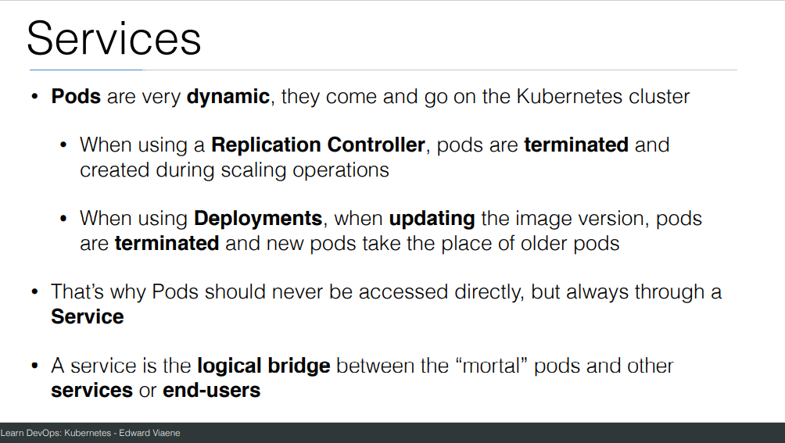

Slide 71
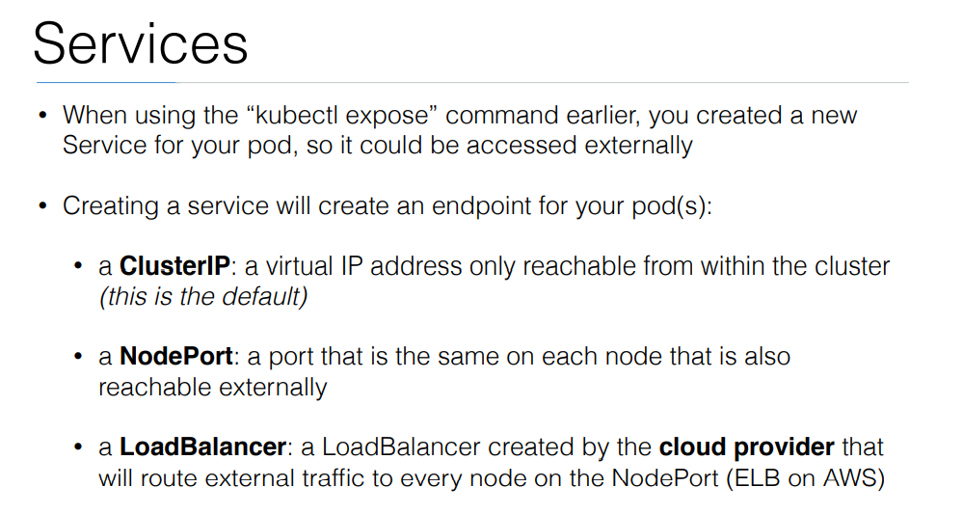

Slide 72
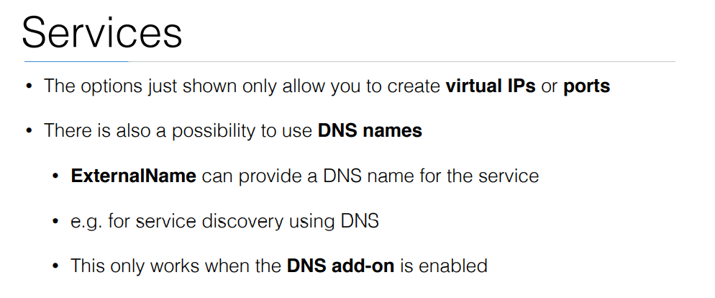

Slide 73
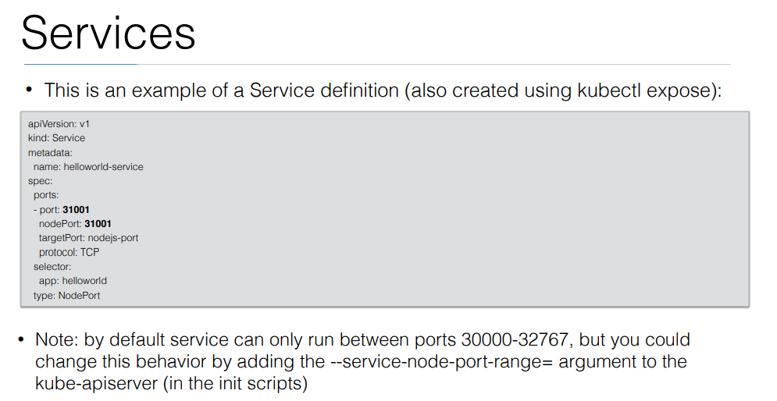

Slide 74
Exercise: Run image as pod
Hands-on steps:
Step 1: Open VS code and create new folder
Step 2 : write manifest file pod3.yml, copy code from below link
https://github.com/arjunachari12/k8s-learn/blob/main/pod3.yml
Step 3: Execute pod.yml file using below command
kubectl create -f pod3.yml
Step 4: You should see pod created message
Step 5: run below commands
kubectl get pod
kubeclt describe pod pod3

Slide 75
Exercise: Expose pod as Service
Hands-on steps:
Step 1: Open VS code and create new folder
Step 2 : write manifest file pod3-service.yml, copy code from below link
https://github.com/arjunachari12/k8s-learn/blob/main/pod3-service.yml
Step 3: Execute pod3-service.yml file using below command
kubectl create -f pod3-service.yml
Step 4: You should see pod created message

Slide 76
Ingress
In Kubernetes, an Ingress is an API object that manages external access to services within a cluster, typically HTTP or HTTPS traffic.
It provides a way to expose your services to the outside world by routing traffic based on hostnames or paths to specific services running in the Kubernetes cluster.

Slide 77
Ingress
Ingress Controller:
This is a specialized load balancer responsible for fulfilling the Ingress rules. It watches the Kubernetes API for changes in Ingress objects and updates the routing configurations.
Common controllers include NGINX, Traefik, and HAProxy.
Ingress Resource:
This defines how traffic should be routed. You can specify rules that map requests (e.g., based on hostnames, paths) to corresponding services within the cluster.
Example: Traffic to myapp.example.com goes to the backend service myapp-service.

Slide 78
Features of Ingress
Path-based Routing: You can route traffic to different services based on URL paths.
Example: /api could be routed to one service, while /admin could be routed to another.
Host-based Routing: Ingress allows you to route based on the hostname (e.g., app1.example.com goes to one service, and app2.example.com to another).
TLS/SSL Termination: Ingress can handle SSL termination, which means it can handle HTTPS requests, often using certificates managed by Kubernetes secrets.
Load Balancing: Ingress provides a way to load balance traffic across multiple instances of your services.
Rewrite Rules and Headers: Some Ingress controllers support rewriting URL paths or adding/removing headers for requests.

Slide 79
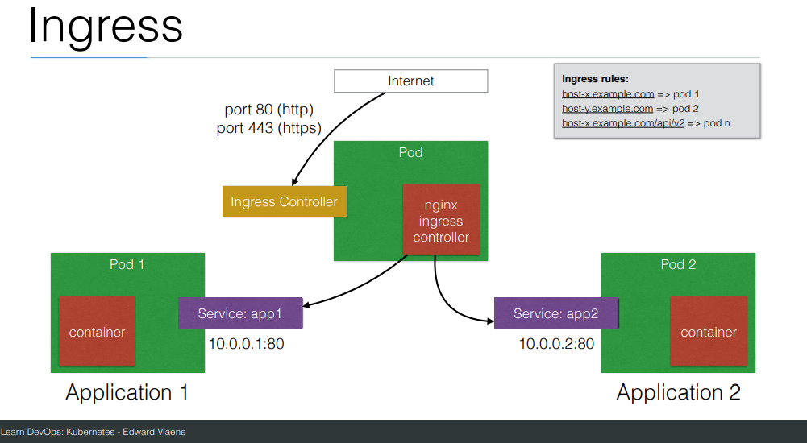

Slide 80
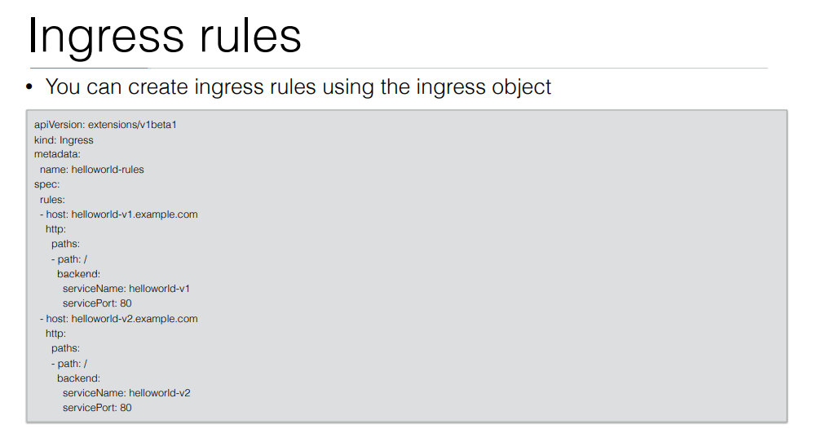

Slide 81
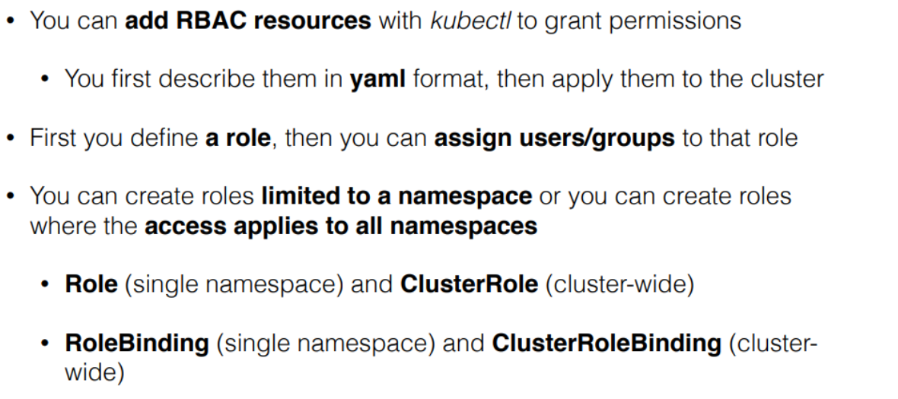
RBAC

Slide 82
Exercise: Expose pod as Service
Hands-on steps:
Step 5: run below commands
kubectl get pod
kubeclt describe pod pod3
kubectl get svc
minikube service helloworld-service --url
kubectl describe svc helloworld-service
kubectl describe svc
Kubectl get svc
kubectl delete svc helloworld-nodeport-service.yml

Slide 83
Kind
Since the clusters are containerized, they are lightweight, easy to spin up, and tear down.
You can simulate multi-node Kubernetes clusters by running multiple Docker containers that act as different nodes within the cluster.

